Slide 1
Smart street light using nodemcu and ldr
AASRITHA
AISHWARAYA

Slide 2
TABLE OF CONTENT
INTRODUCTION
COMPONENTS
WORKING
CONCLUSION
FUTURE WORK

Slide 3
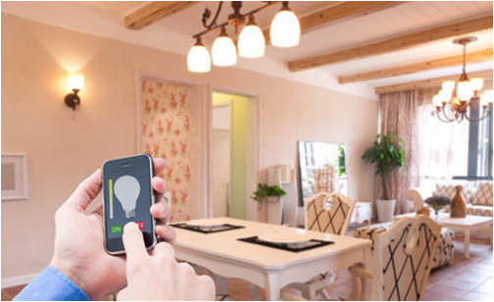
INtRODUCTION
The primary feature is controlling the lights from any device connected to internet
The Smart Lighting system has 2 modes of working:
Automatic mode
Manual mode

Slide 4
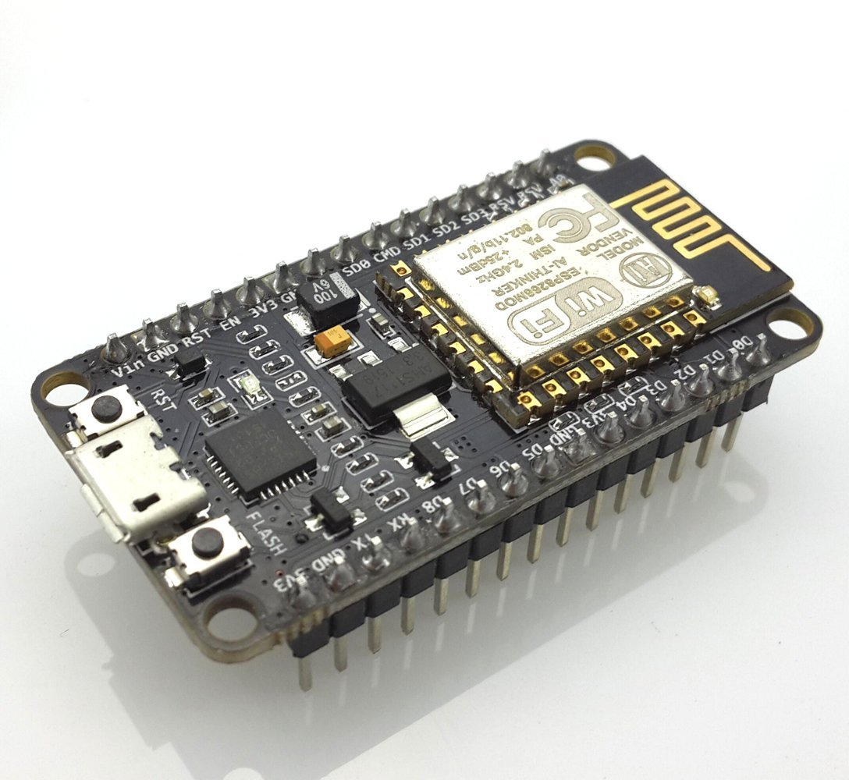
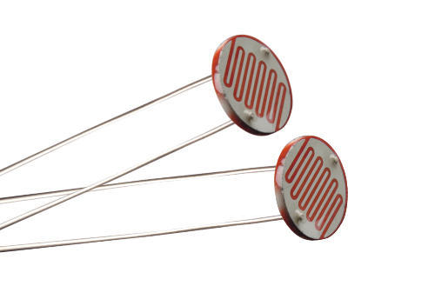
components
NODE MCU
LED
LDR
SOFTWARE USED:ARDUINO IDE
IBM WASTON
MIT APP INVERTOR
This Photo by Unknown Author is licensed under CC BY-NC

Slide 5
WEB PAGE
The web page comprises of 3 buttons :
Turn On :
Turns on the LED
Turn Off :
Turns off the LED
Automatic :
The controls is taken by the nodemcu board based on the output of the ldr.
This can be overridden by simply using the turn on and turn off buttons

Slide 6
Working
LDR offers very high resistance in darkness.in this case the voltage drop across the ldr is more than 0.7v.This voltage is sufficient to switch on the light
LDR offers very low resistance in brightness .in this case the voltage drop across the ldr is more than 0.7v. This voltage is sufficient to switch off the light

Slide 7
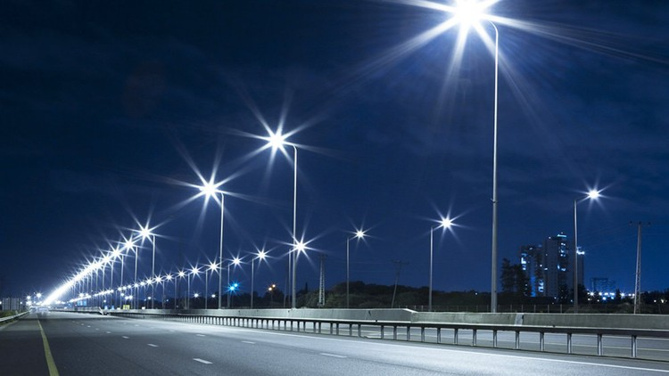
conclusion
Ease of access
Control the lights though internet
Works automatically
Energy efficient

Slide 8

FUTURE WORKS
Using databases
Controlling other factors like brightness and color
Smart street lights can help monitor traffic flow, parking, pedestrian crossings, seismic activity, or atmospheric changes. They can be equipped with speakers to alert people to dangerous situations or conditions, or with cameras to help police solve crimes or to verify trash collection and other activities.

Slide 9
THANK YOU

